Slide 1
<<CUSTOMER>>: API Led With ETL
<<DATE>>

Slide 3
Agenda
Changing the Clock Speed of Business
API Led Full Lifecycle Management
ETL with Anypoint Platform
Wrap Up and Next Steps

Slide 4
Digital pressures create a widening IT delivery gap
IoT
Mobile
Big Data
Demands on IT
Cloud and SaaS
IT delivery capacity
Time
Today
Notes:
Introductions around the room:
What are we seeing the market?
We are in unprecedented times where a convergence of new technology forces are changing the whole dynamic of how companies interact with customers and how customers expect to be treated and communicated with.
This is creating huge pressures from the business to IT. Most organisations can be represented with this simple graph. Companies only have a finite delivery capacity which is fairly steady. With the emergence of technologies such as IOT, Mobile, Big Date and Cloud there is an ever accelerating IT delivery gap which is only going to get worse
IT used to deliver everything on a project by project basis and this worked fairly well. Now all these disruptors have entered the market which is creating more and more demand from the business that IT cannot respond to at speed.
.
Do you see this as a problem within your organisation? How have set out to deal with this and is there a widening gap within GHD?
We have seen a number of responses to try and counter this delivery gap:

Slide 5

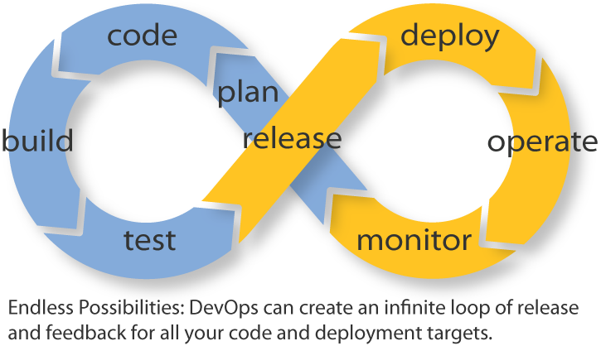
Current responses are insufficient
Working harder
Over outsourcing
Agile / DevOps
Not
sufficient
Not sustainable
Exacerbates
the situation
Notes:
Can ask people to work harder but its human nature to take shortcuts to make deadlines. A lot custom code can be written with no thought on re-sue and re-leveraging assets in the future which is not sustainable.
Outsourcing has its place but business’s are rapidly losing IP by not having the right resources internally and 3rd parties often aren’t aligned with the same values as the customer
3 A gile Dev ops- we here at MuleSoft advocate this approach but its not sufficient. if this is being applied on a project by project basis then we’re not getting the long term effect of re-usable solutions. Very important that we get better at prioritisation that will drive a multiplier effect

Slide 6
A new way of working to close the delivery gap
Consumption and innovation
New IT operating model
Demands on IT
IT delivery capacity
Enablement and assets
Time
Today
Notes:
Here at MuleSoft we are not just providing leading class technology but also a proven view point on a new new operating model to go hand in hand with our platform.
We will be touching on this as we go through the work shop….
We are helping companies globally change the way they go about delivering projects to ensure consumption and re-use at scale. It’s not just about focusing on a project by project basis but enabling IT to drive business outcomes and transformation.
Let’s look at this a bit more closely

Slide 7
New operating model emphasizes consumption
LoB IT, developers
Consumption
Discoverable
Reusable assets
Feedback and
usage metrics
Self-service
Production
Central IT / LoB IT
Notes:
By Changing from a production to a consumption operating model, MuleSoft enables IT to shift from starting from scratch on every new project to an approach that lets them leverage reusable assets that can easily be consumed by a broader audience with speed and agility.
Central IT produces assets that are made discoverable and can then be self serviced by lines of business for their projects without the need to approach IT to re-produce.
If you can do this properly then you will drive re-use and faster delivery of projects.
Let’s walk through an example to better demonstrate this

Slide 8



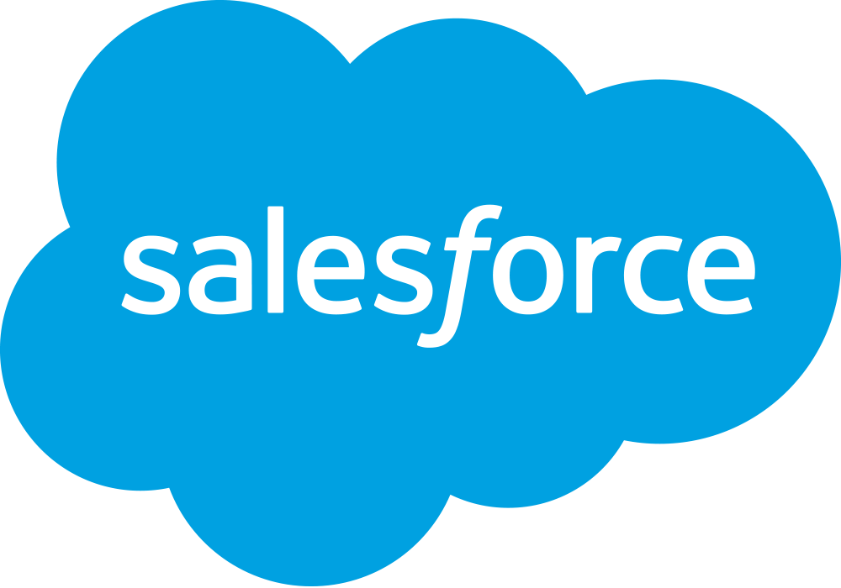

A common project-based approach
Web app API
Project objective: Web app provides real-time order status and order history for sales team engaging with customers
Order status
Order history
Order data in eCommerce system
Inventory data in SAP
Customer data in SAP, Salesforce
Aggregated customer data
Notes:
Sales team have a need to get data from systems of record into a web app. You can create a point to point with custom code to achieve the project deadline. But there’s no thought to how you manage that, govern it and re-use it?
Custom code, point to point. It get’s the job done and we all know that but there is no thought put into long term re-use and governance of assets which can cause delays lead to repetitive work and bottle necks in the future when more demands are made from the business especially with the ongoing demand for SaaS applications
The key question arises that does this approach actually meet business objectives?
.

Slide 9
A common project-based approach
On time and within budget
Web app API
Limited opportunity for reuse
Tight coupling = brittleness
Order status
Order history
Difficult to govern
Aggregated customer data
?
Meets business requirements
Notes:
Slide takeway: The project-based approach may meet the first project’s timelines and budget, but it is throw away work, which cannot be reused, which can easily break and is impossible to secure and monitor
Transition: What impact does it have with the next project.
This approach may meet project timelines and even come in within budget, but nobody can reuse any of the assets (code) developed. While this approach may seem to be hitting project timelines, it is not meeting business requirements for governance, visibility and most importantly, longer term speed.
Moreover, the app is now tightly coupled with the project or to the underlying endpoints. If anything changes the entire app or major portions of the code need to be rewritten.
The next application to be built that uses similar data will be built form the ground up every time, which means you’ll need the same system experts to get the data out of the source systems.
As nothing is registered for security or governance or management, you have lost any visibility as to what is actually going on.
In other words… Code is expensive and none of the code written can be used again beyond the current project.
This approach also chips away at an enterprise’s ability to change
Transition: What impact does it have with the next project.

Slide 10

A common project-based approach
mobile API
Web app API
Mobile API
Web app API
Integration project
Order status
Order history
Order status
Order history
Aggregated customer data
Aggregated customer data
Notes:
Fast forward 6 months and the sales team now want the same information but this time in a mobile app…
Using the same approach leads to a duplication of the original work, even more tightly coupled connections withno flexibility or agility and creating bottle necks throughout the business.
We believe there is vastly better approach through what we call a modern approach to API connectivity.
In the new operating model, you package up core IT assets and capabilities in the Modern API.
The modern API has taken on some characteristics that in our opinion completely change the game:
They adhere to standards, are developer friendly, easily accessible and understood broadly. Ie google/Air bnb
They are treated more like products than code and are deigned for consumption for specific audiences as well as being documented and versioned.
They underpin our API led approach to integration and it is the way to develop, build and manage conenctivity within CBRE

Slide 11

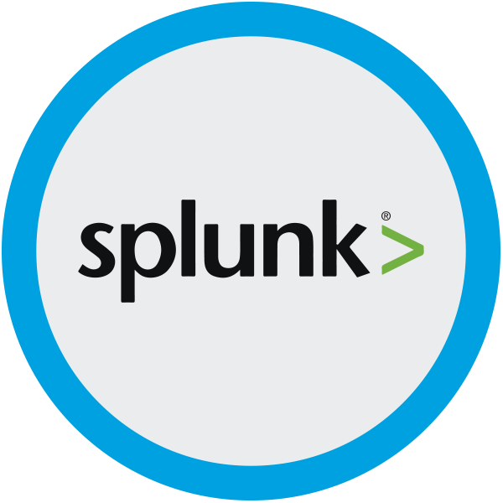
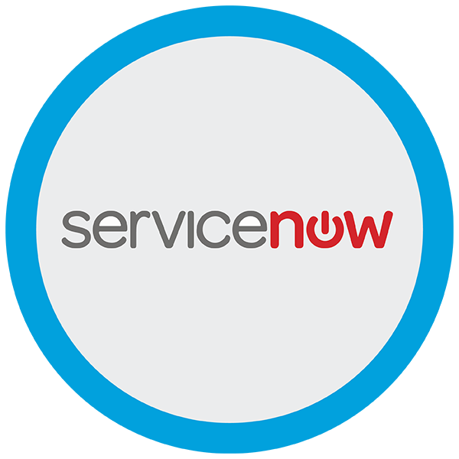
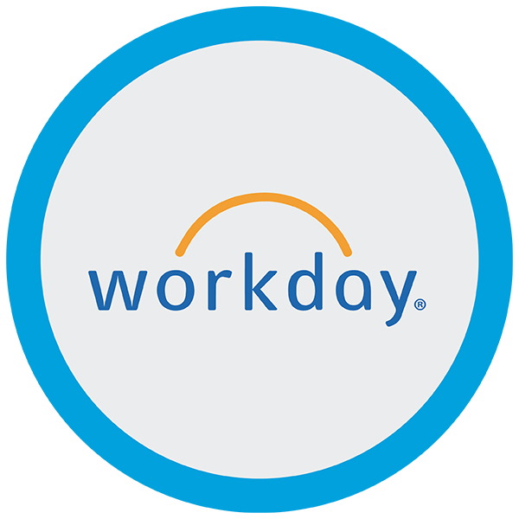


Modern API: the core enabler of a new operating model
Discoverable and accessible through self-service
Productized and designed for ease of consumption
Easily managed for security, scalability, and performance
Notes:
The modern API has taken on some characteristics that in our opinion completely change the game:
They adhere to standards, are developer friendly, easily accessible and understood broadly. Ie google/Air bnb
They are treated more like products than code and are designed for consumption for specific audiences as well as being documented and versioned.
They underpin our API led approach to integration and it is the way to develop, build and manage conenctivity.
This underpins our API led approach to integration and let’s see how this looks using the previous project we just discussed:
Because they are much more standardized, they have a much stronger discipline for security and governance, as well as monitored and managed for performance and scale
As any other piece of software that is productized, the modern API has its own software development lifecycle (SDLC) of designing, testing, building, managing, and versioning. Also, modern APIs are well documented for consumption and versioning

Slide 12

The API-led connectivity approach
Mobile API
Web app API
Experience
APIs
Order
status
Shipment
status
Order
history
Process
APIs
Customers
Orders
System
APIs
Toll
shipments
UPS
shipments
SAP
customers
Salesforce
customers
Notes:
API-led connectivity provides an approach for connecting and exposing assets. With this approach, rather than connecting things point-to-point, every asset becomes a managed API, which makes it discoverable through self-service without losing control.
Let’s look at the same project as before with this new approach…
In this example, you unlock data from SAP, Salesforce and ecommerce systems by putting APIs in front of them. These form a “System API” layer, which provides consistent, managed, and secure access to backend systems. There is a Single point of entry and single point of governance.
Process APIs: Then, in our example, you can build on the system APIs by combining and streamlining customer data from multiple sources into a “customers” API (breaking down application siloes). Then mapping customers and orders to create order status and order history APIs. These “process APIs” take core assets and combine them with some business logic to create a higher level of value. Importantly, these higher-level objects are now useful assets that can be further reused, so they should also be APIs themselves.
Experience APIs: Finally, in our example, an API is built that brings together the order status and history, delivering the data specifically needed by the Web app. These are “experience APIs” that are designed specifically for consumption by a specific end-user app or device. These APIs allow app developers to quickly innovate on projects by consuming the underlying assets without having to know how the data got there. In fact, if anything changes to any of the systems of processes underneath, it shouldn’t require any changes to the app itself.

Slide 13
Drive outcomes with API-led connectivity
On time and within budget
On time and within budget
Experience
APIs
Experience
APIs
Drives reuse vs build
Limited opportunity for reuse
Designs in readiness for change
Tight coupling = brittleness
Process
APIs
Process
APIs
Builds in governance, compliance, security, and scalability
Difficult to govern
System
APIs
System
APIs
Meets business requirements
?
Meets the needs of your business
Notes:
The question then arises does API led connectivity drive business outcomes? Yes…
Slide takeway: With API-led connectivity as opposed to a project based approach, you are not only on time and budget with your first projects but you have driven reuse vs rebuild, created an infrastructure which is designed for change, you’ve build in visibility, compliance and governance and most importantly, it meets the needs of the business which is long term sustained agility
-API-led connectivity liberates resources to innovate and to move quickly
Transition: MuleSoft API building block, stepping back and wanted to quickly highlight on this. Critical to the success
Desperation comment before and urgency.

Slide 14

An approach to unlocking your organization
App Dev
Experience Layer: Innovation and digital products
LoB Dev/IT
Process APIs: Agility and new value creation
Central IT
System APIs: Decentralized access to core assets
Accessibility
& Ownership
SaaS apps
Mainframe
FTP, Files
Databases
Web services
Legacy Systems
Notes:
To summarise This approach is designed to unlock the organisation, increase agility and speed of delivery and future proof the organisation against the continuing changes in technology:
Central IT – unlock key systems and decentralzie access to information.
LOB IT – Can reuse and compose process level information with agility and speed to create value
App Developers can self service and ultimately focus on their real impact at the end user application.
We will help eliminate bottlenecks and enabled self service within Boral
3 layers – production and consumption model with reusable assets, which are discovered and self services by downstream IT and developers.
SYSTEM APIs: If it's a mainframe, you'll want to expose its capabilities as productized system APIs: this is our virtual system for inventory, this is our virtual system for payroll, etc. Of course you can connect to these systems directly and integrate at this level, or you can abstract them behind APIs so you can be independent of them when you create your integrations – whichever approach makes sense for each case, you can easily do with Mule and Anypoint. And once you set it up, you can rely on it to "just work", as customers always tell us.
PROCESS APIs: Now that you've identified your systems and exposed them as APIs, you'll want to integrate some of them and expose them as business processes. Some processes are headless: whenever a customer is added, add an entry in the loyalty system, and update the ERP system. Others you'll want to expose as process APIs: this is our process for adding a customer, this is how we take an order, this is how we see everything about a client, and hide the complexity of multiple systems behind that APIs. If needed, you can also integrate entire processes together: the employee onboarding process can then trigger an IT provisioning process.
EXPERIENCE APIs: Finally, companies are increasingly following the lead of innovators such as Netflix and creating a third layer of APIs: experience APIs, These are tailored to front-end consumption experiences, such as the mobile apps we started with, or certain partner applications. These experiences often have very different requirements, e.g. the mobile app should be able to get most of the information it needs to refresh itself with a single API call, so its experience API will be very coarse-grained, and will mashup a number of process APIs underneath it. A partner API will expose certain capabilities that makes sense within the limits of the partnership, vs having access to the broad range of internal processes available to internal business groups.
So this is your target architecture. You'll see it's not a monolith, it's not static, and it isn't something you ever finish – it's a constant work in progress, but it's got guiding principles, it's very consistent and repeatable, it's got sanity baked into every layer, with the right controls and the right tools and the right levels of abstraction that make it work for each audience, internal and external. It affords visibility too, automatically. Over time, you build institutional muscle memory as you get good at this, and instead of growing fat with technical debt like you used to, you actually get lean and mean and can accelerate the pace of innovation.

Slide 15
Agenda
Changing the Clock Speed of Business
API Led Full Lifecycle Management
ETL with Anypoint Platform
Wrap Up and Next Steps

Slide 16
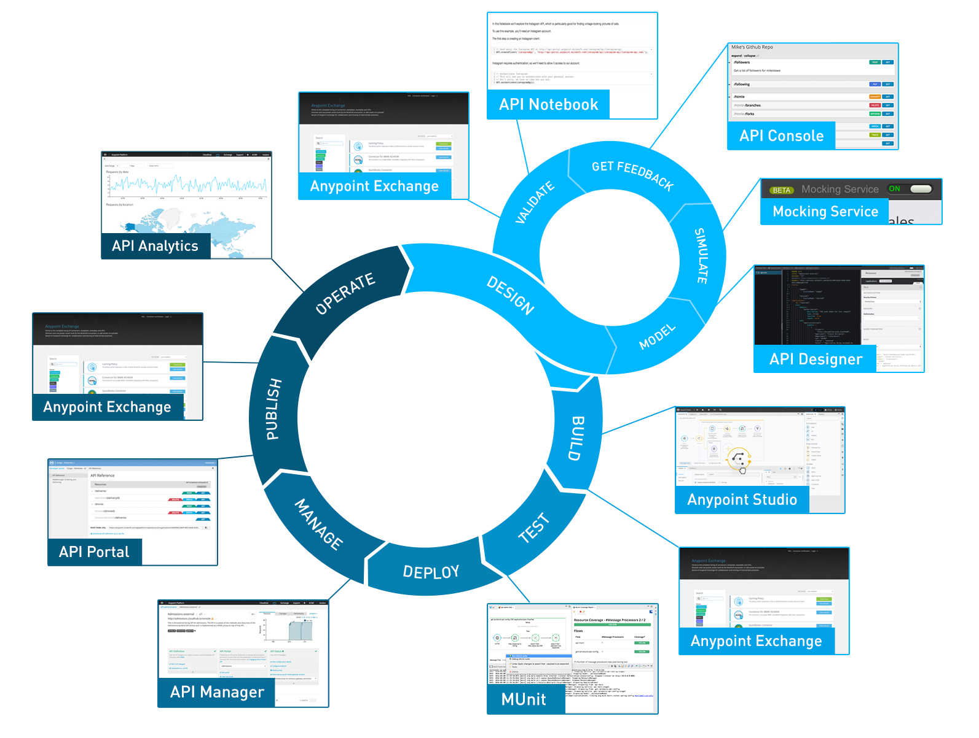
Full API Lifecycle

Slide 17
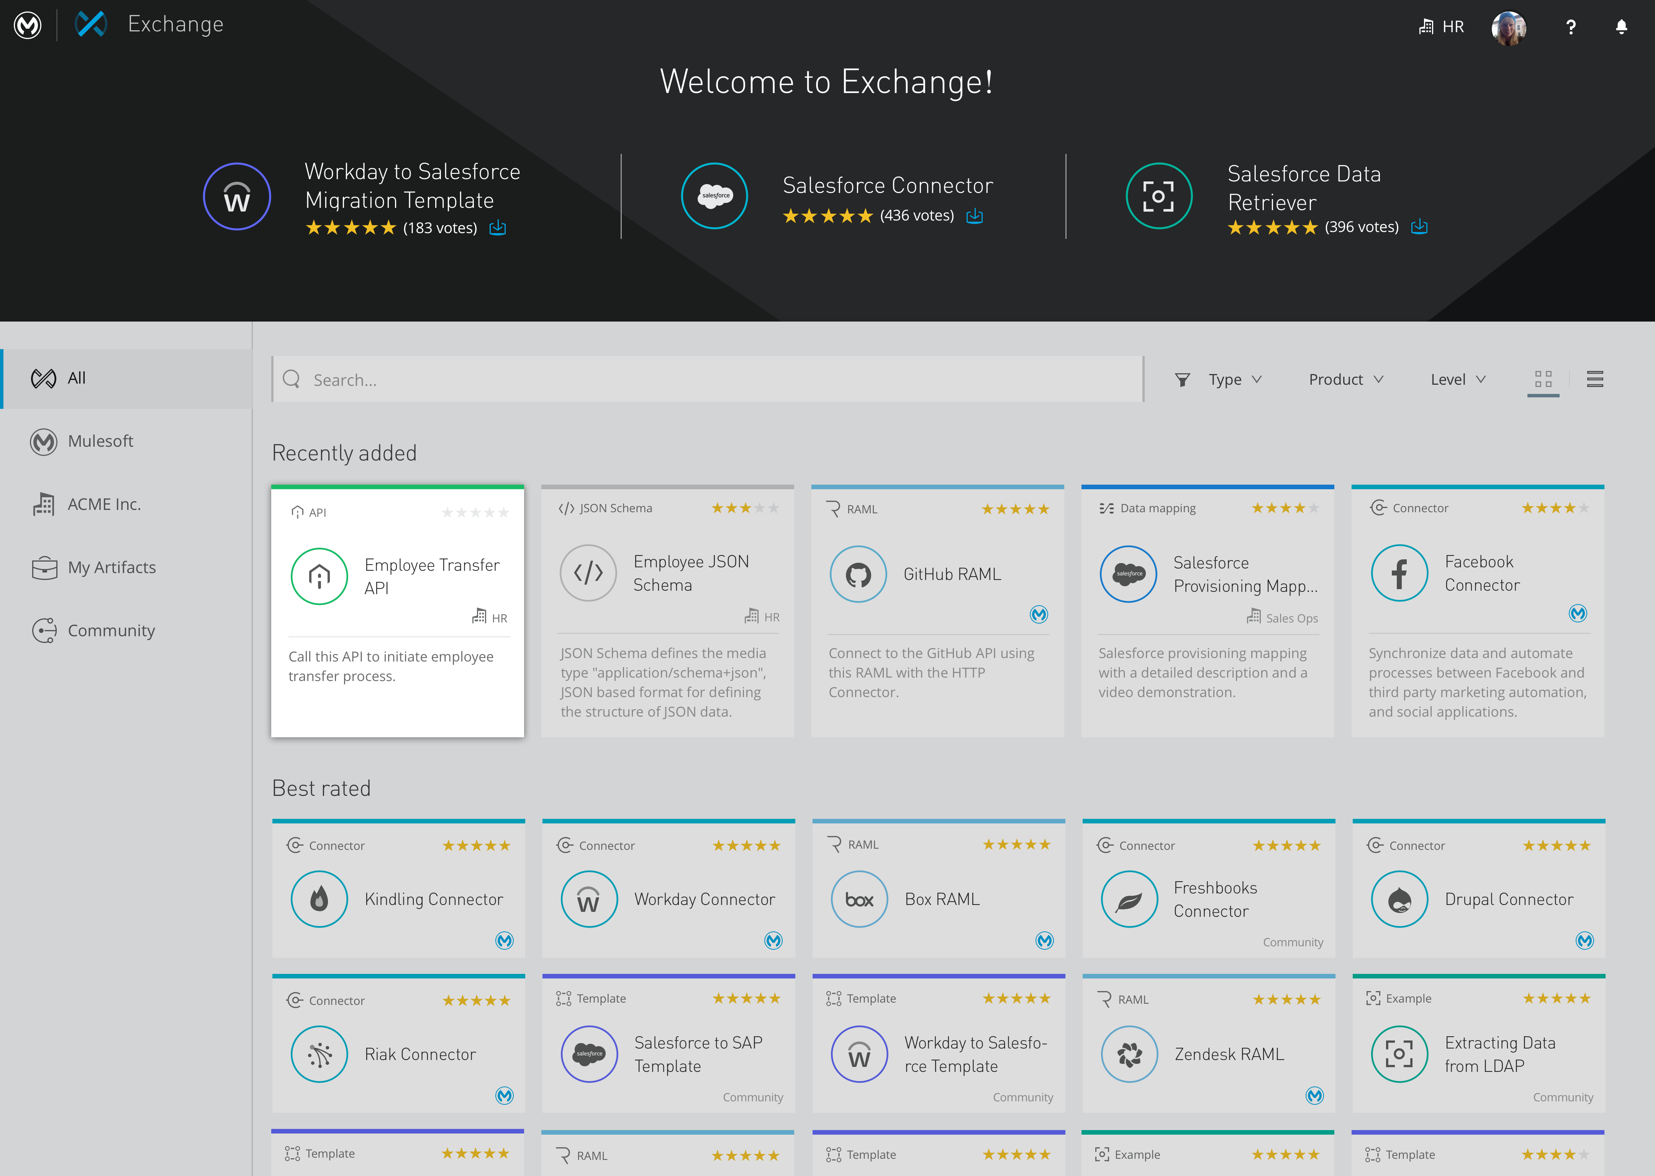
Order Status
API
Order API to track the status of an order.
17
Notes:
Then you advertise it, share it, make it discoverable

Slide 18
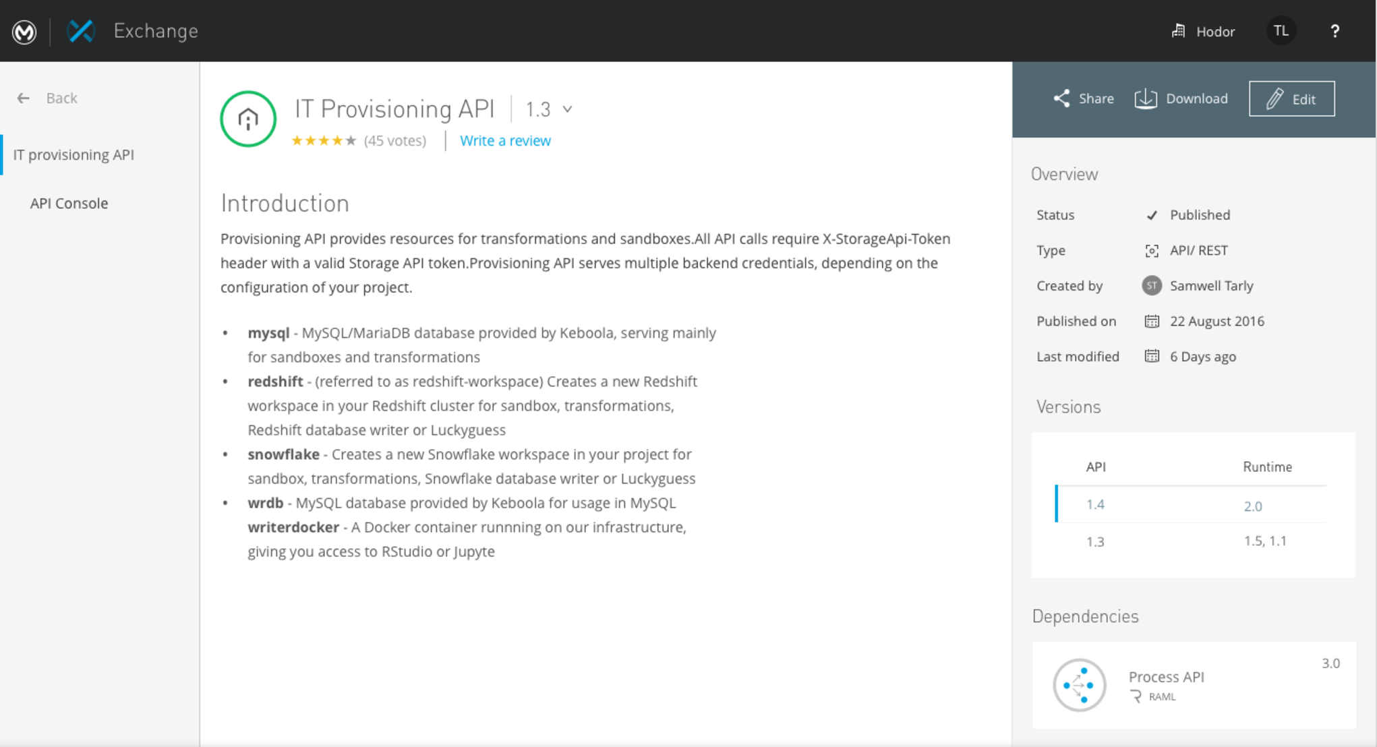
Order API
Notes:
Discovery – API Portal

Slide 19
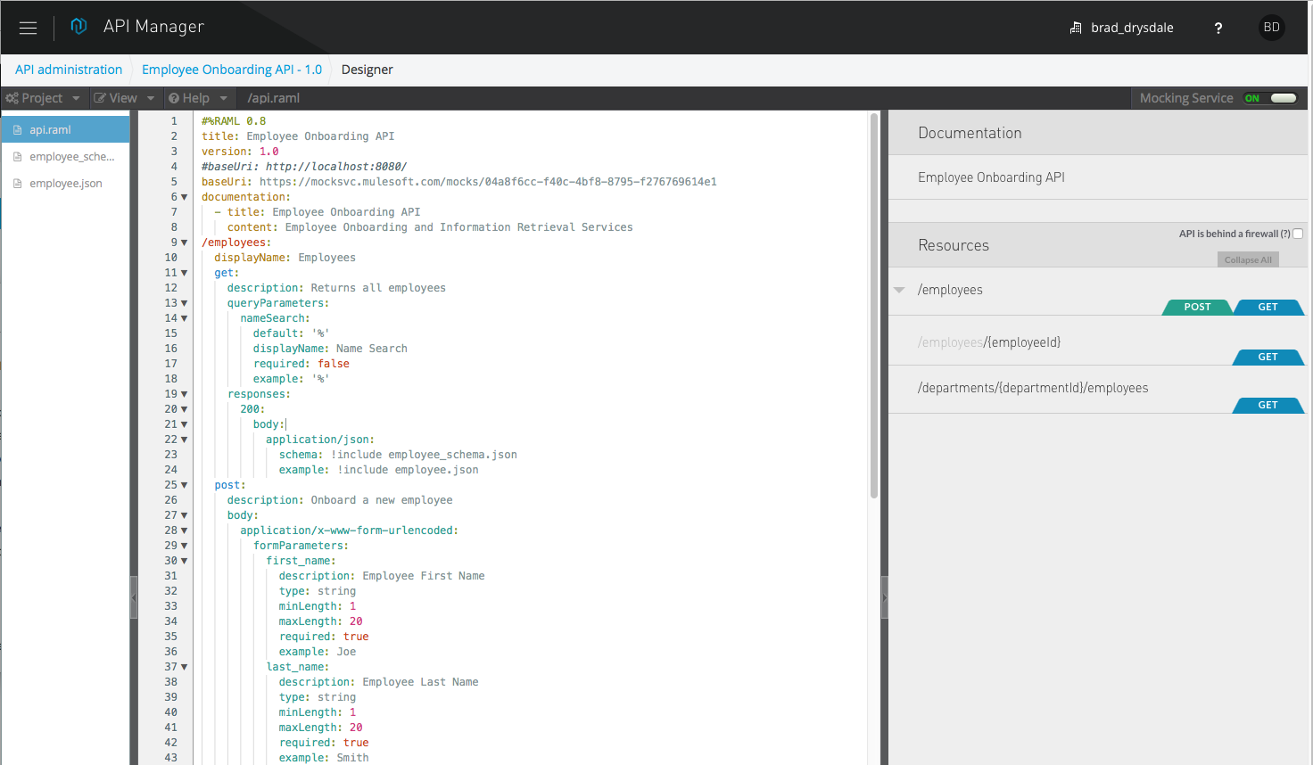
Let’s show, not tell…
Notes:
Design-first with RAML

Slide 20
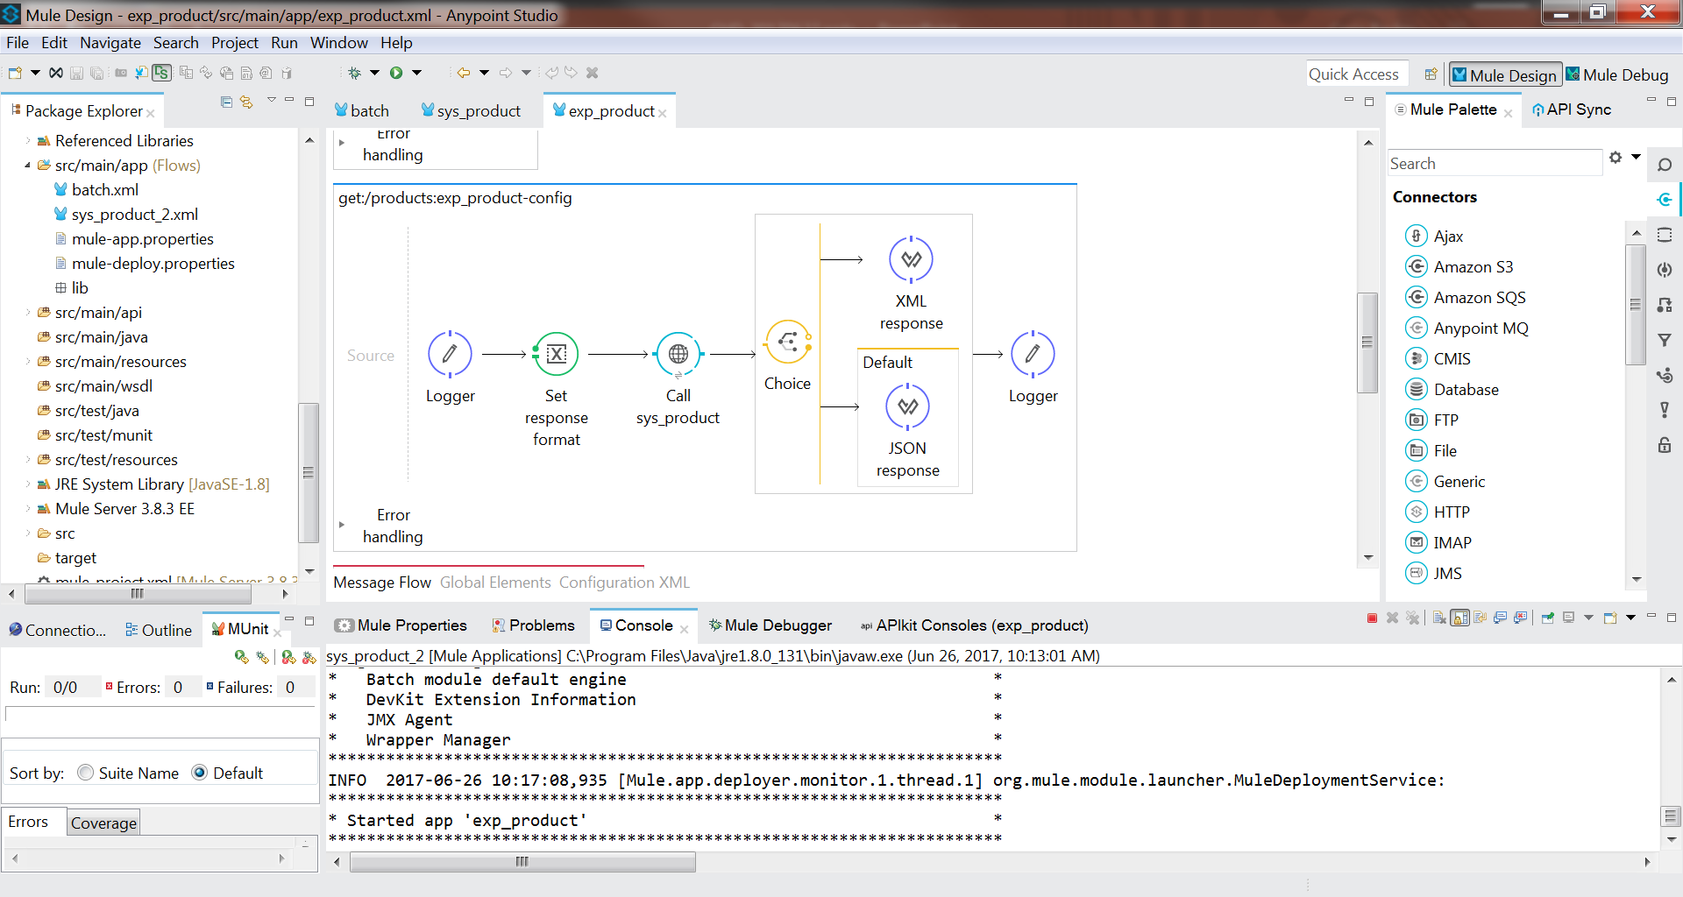
More later…
Notes:
Deep Connectivity as part of the same runtime.
Good Security and Governance applied dynamically at runtime.

Slide 21
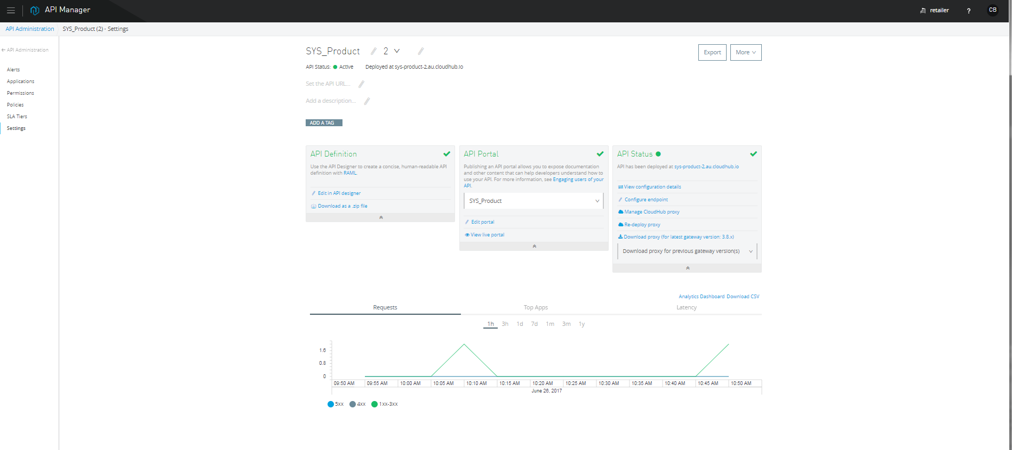
API Manager
Let’s show, not tell…
Notes:
Deep Connectivity as part of the same runtime.
Good Security and Governance applied dynamically at runtime.

Slide 22
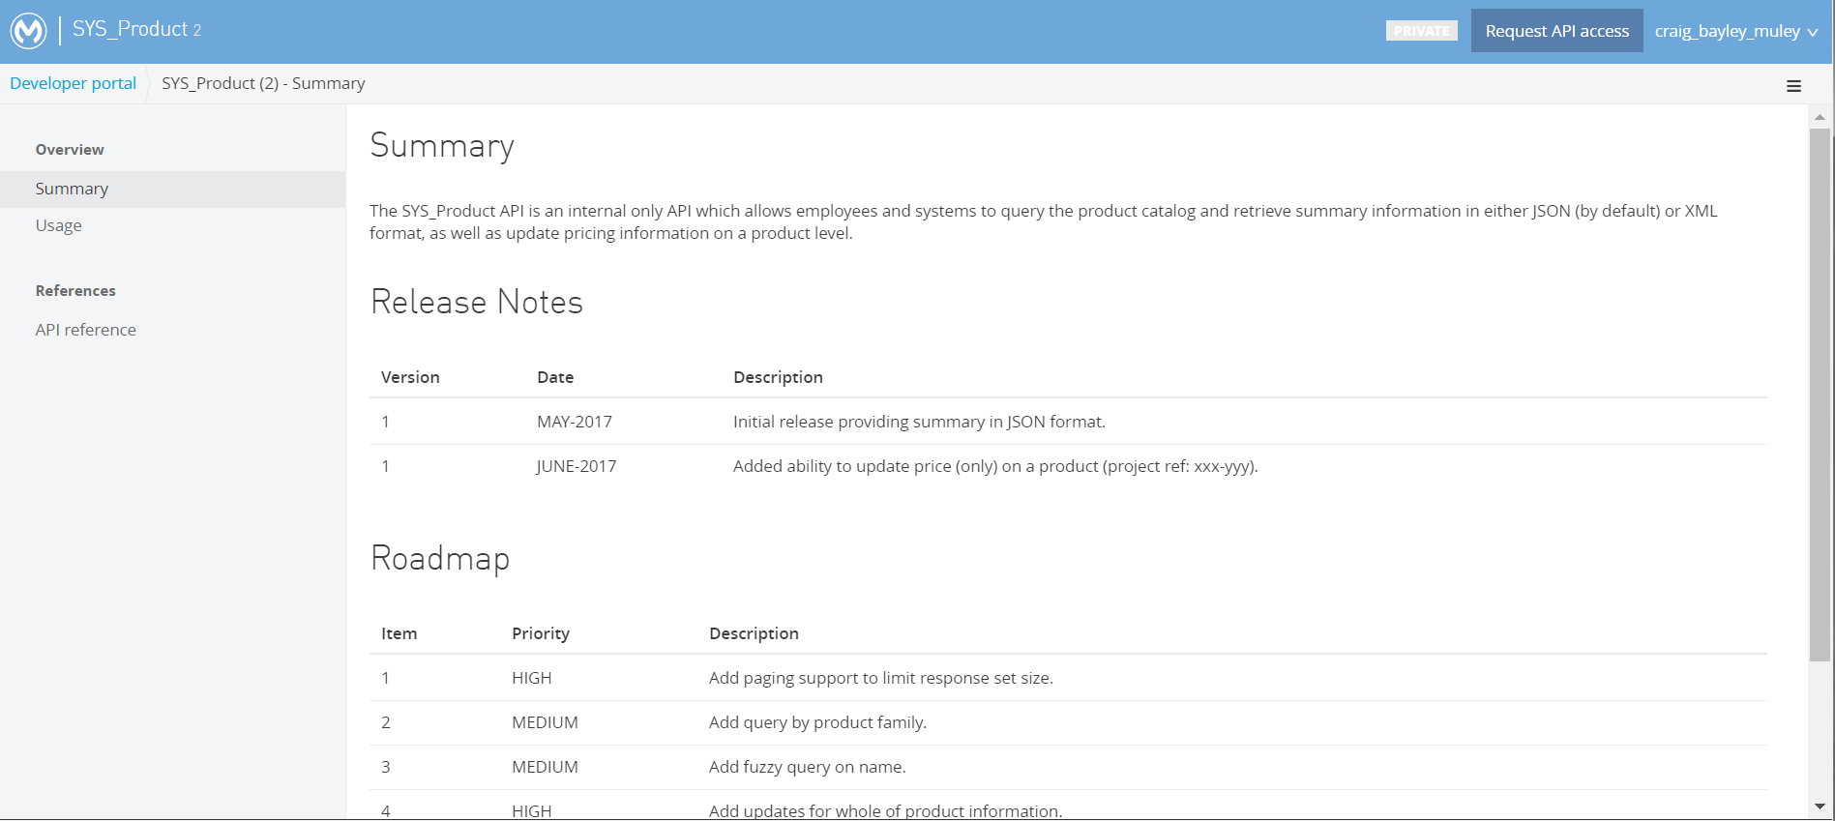
API Portals & Developer Sign Up
Let’s show, not tell…

Slide 23








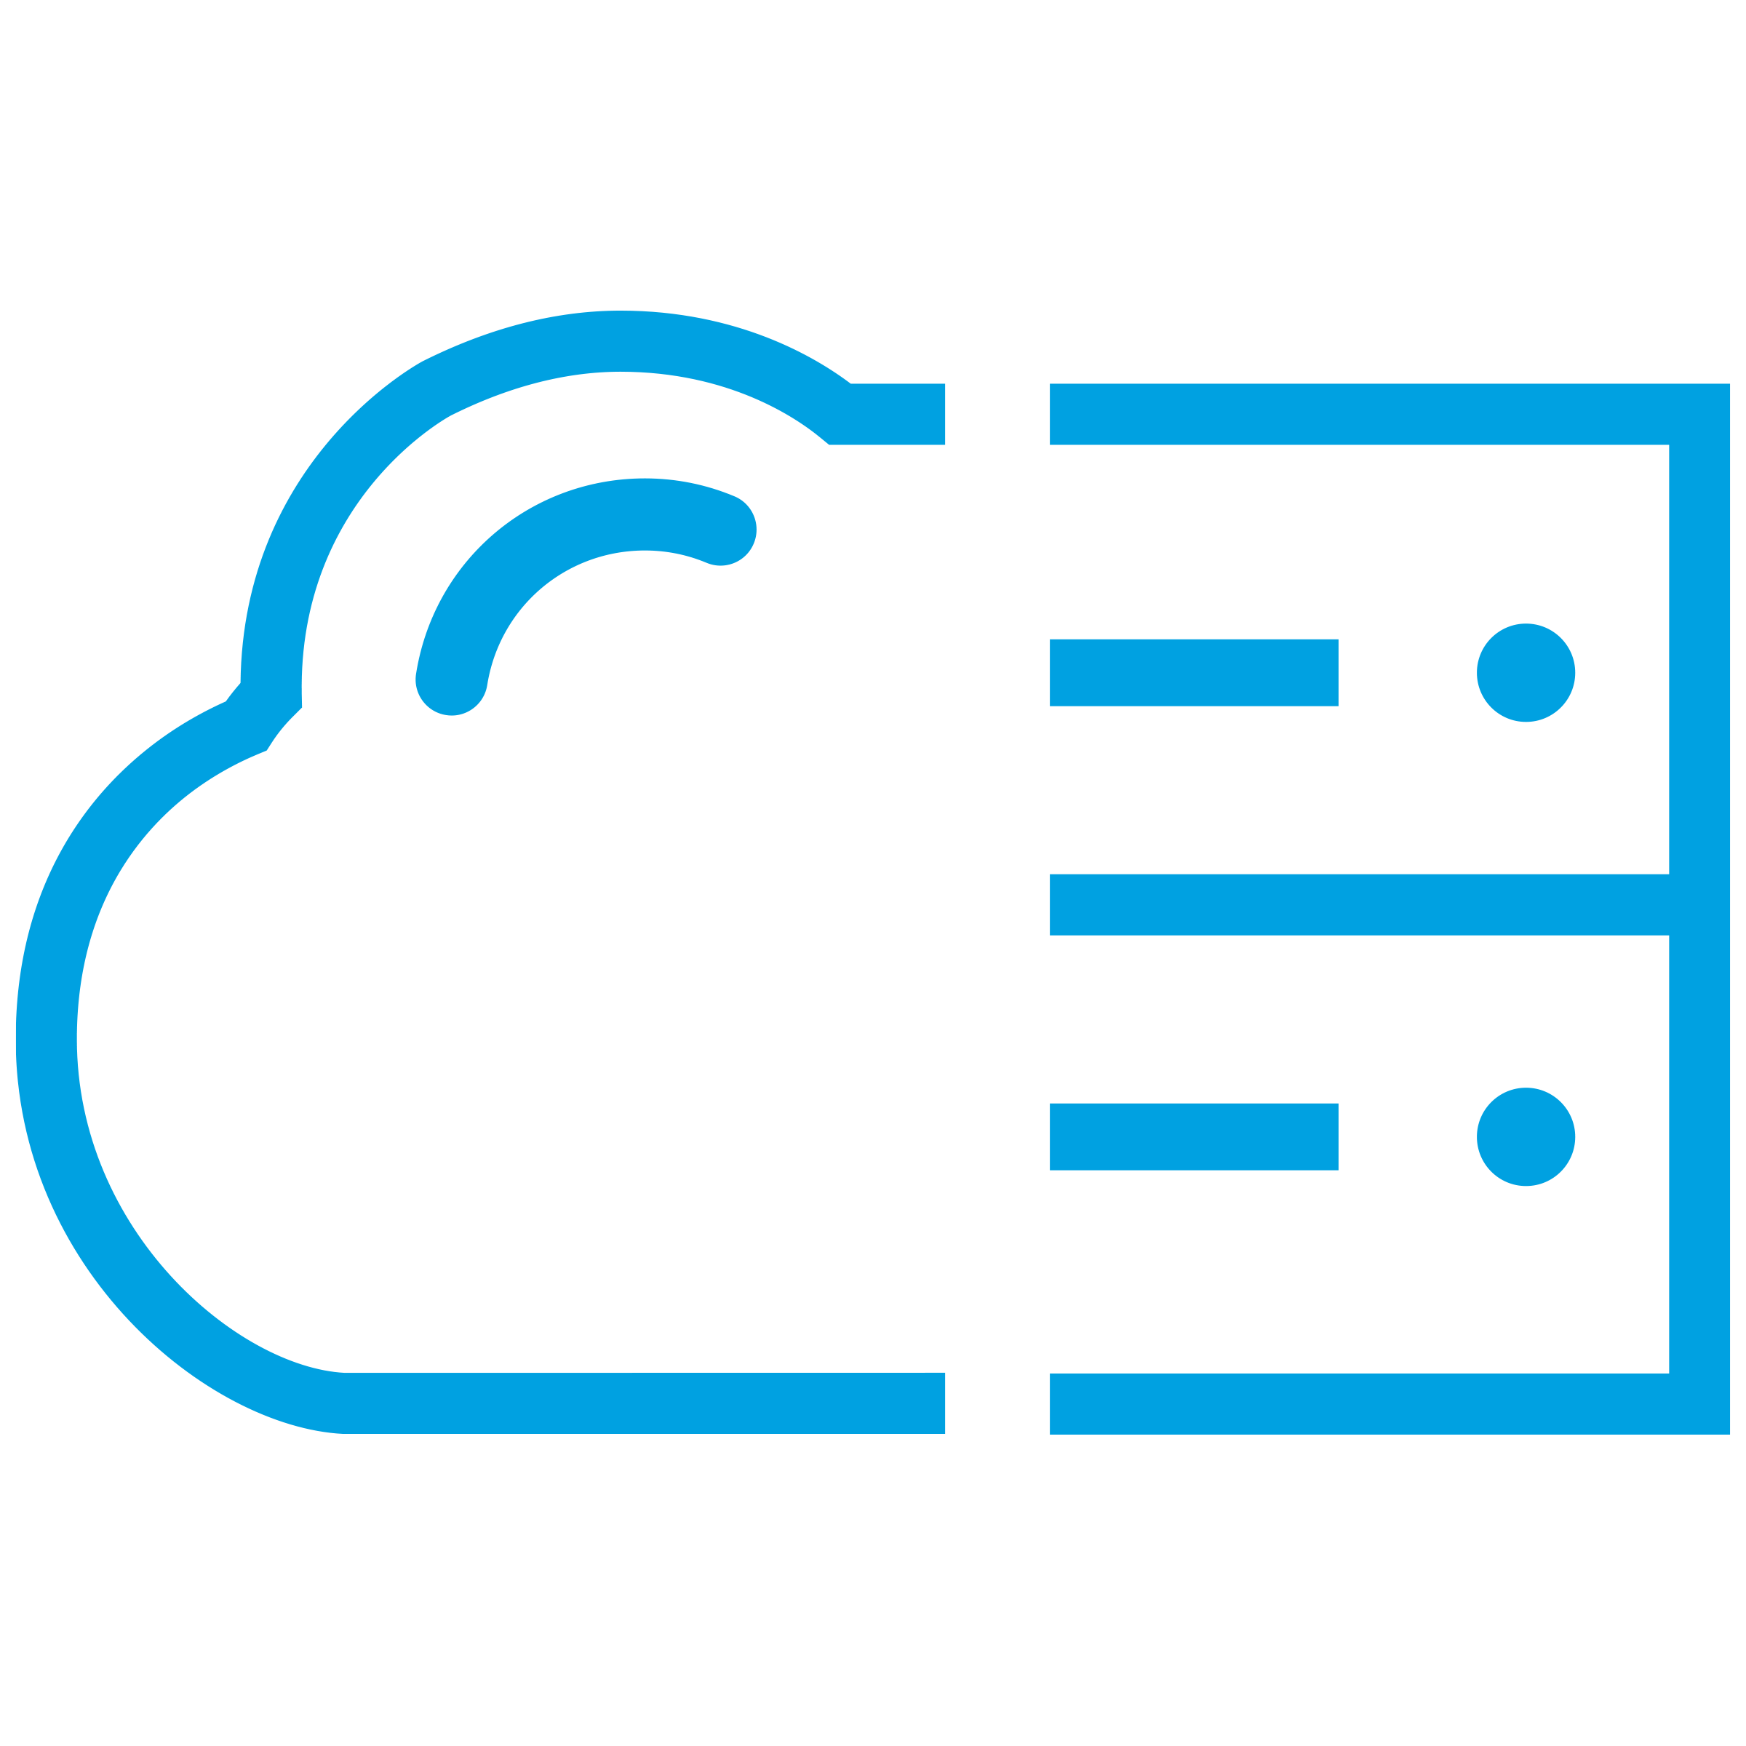
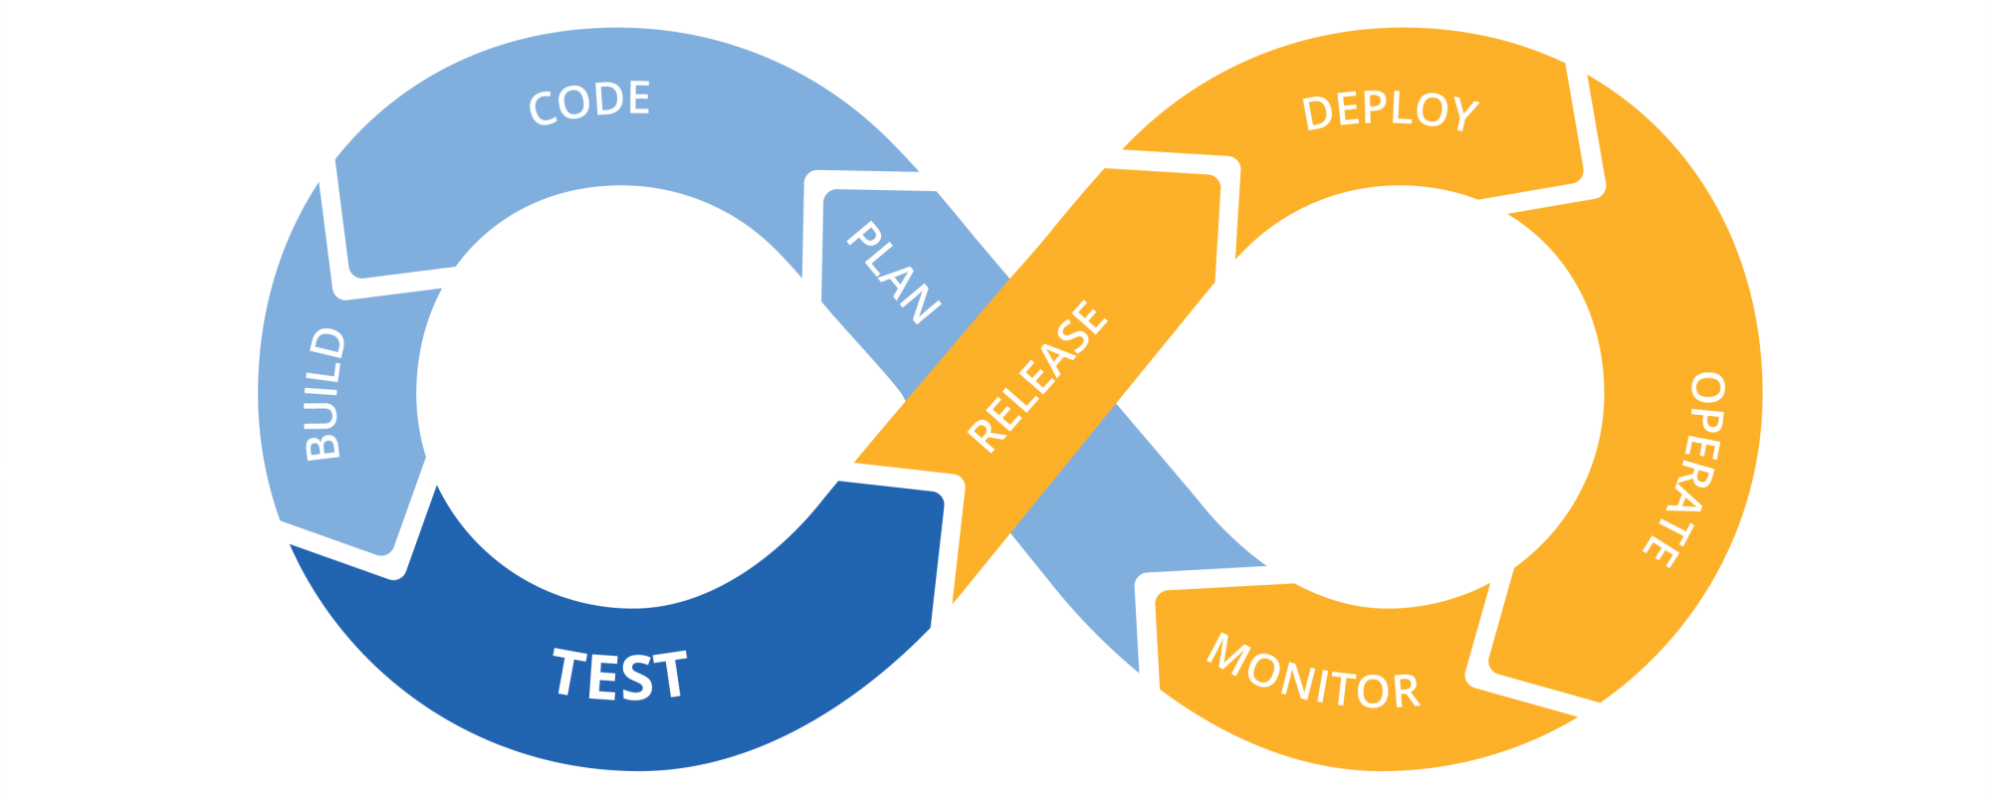
Deploy and Run
Notes:
Then you deploy and run it.
Whether you deploy: On-prem, Cloud, Hybrid
With architecture of more: Layered or Microservices
Whether you Containerise or not
Leveraging your CI/CD, DevOps, Agile methodologies
Anypoint Platform has got your back.

Slide 24
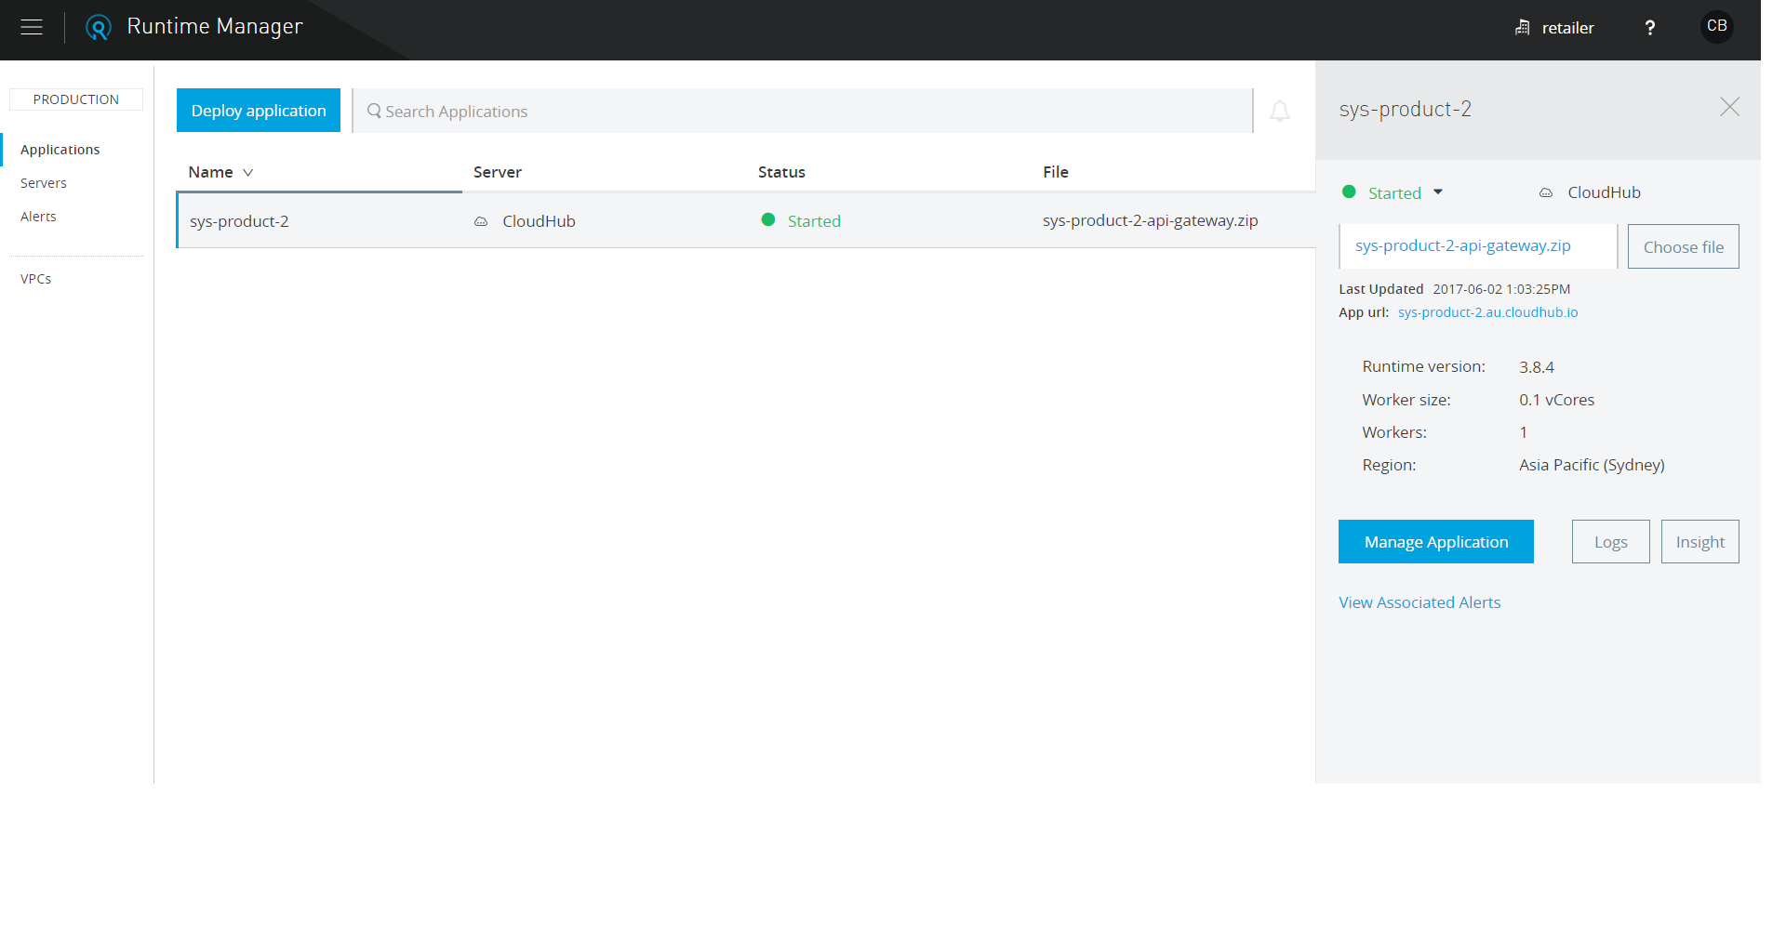
Runtime Manager
Let’s show, not tell…
Notes:
Then you deploy and run it.
Whether you deploy: On-prem, Cloud, Hybrid
With architecture of more: Layered or Microservices
Whether you Containerise or not
Leveraging your CI/CD, DevOps, Agile methodologies
Anypoint Platform has got your back.

Slide 25
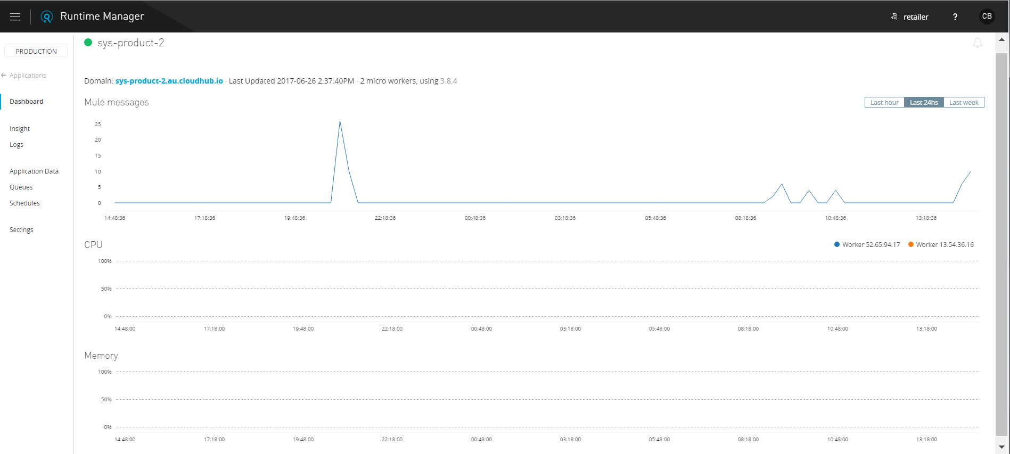
Runtime Manager – Manage Application
Let’s show, not tell…
Notes:
Then you deploy and run it.
Whether you deploy: On-prem, Cloud, Hybrid
With architecture of more: Layered or Microservices
Whether you Containerise or not
Leveraging your CI/CD, DevOps, Agile methodologies
Anypoint Platform has got your back.

Slide 26
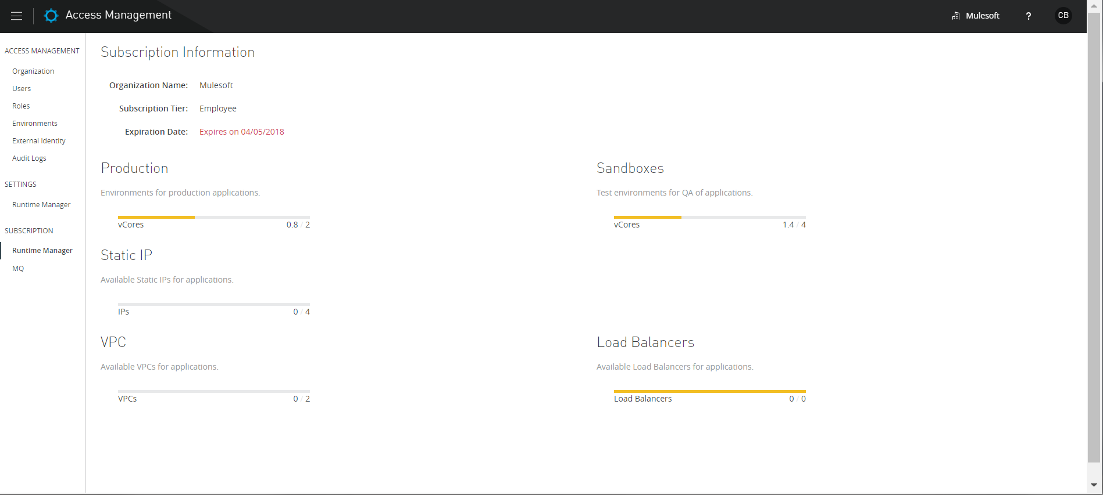
Access Manager
Let’s show, not tell…
Notes:
Then you deploy and run it.
Whether you deploy: On-prem, Cloud, Hybrid
With architecture of more: Layered or Microservices
Whether you Containerise or not
Leveraging your CI/CD, DevOps, Agile methodologies
Anypoint Platform has got your back.

Slide 27
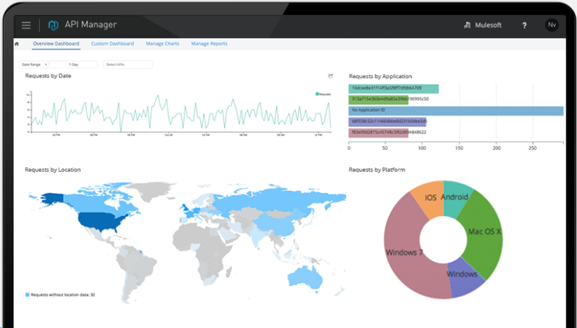
Let’s take a look…
Notes:
And then measure it through rich consumption analytics

Slide 28
<<COMPANY>> API Management Story & Requirements <<TAILOR TO COMPANY>>
“We want to use existing APIs and Web Services to provide speedy solutions to our business. We also want to enable the easy development and support of new APIs or services to get an effort/value multiplier as these are reused across many business solutions.
Please demonstrate how this part of your platform enables this strategy.”
API design – design APIs before coding. Test the API using Mock data before any code is written
API Orchestration – How can we combine lower level APIs to produce a new API for discovery and consumption by others?
Security, Audit usage, Logging, Analytics, Policies
API Catalogue, documentation, code samples and developer self service
Creation of APIs to service Mobile Apps, Internal Business Systems or Integration flows
Easy provision of a new API from a data store or legacy system
Traffic mediation / Protocol transformation to support various systems.
Take us through the life cycle of an API as managed in your offering. Highlight the controls and features available.
Let’s talk this through…

Slide 29
Agenda
Changing the Clock Speed of Business
API Led Full Lifecycle Management
ETL with Anypoint Platform
Wrap Up and Next Steps

Slide 30
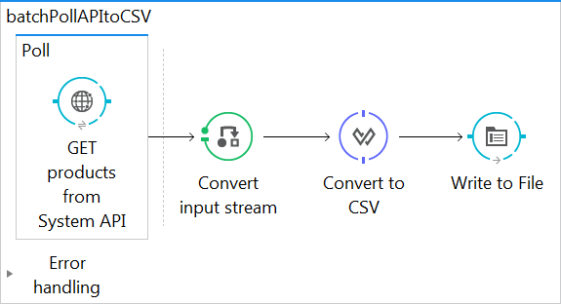
ETL/Batch Using Mule Flows
Mule provides capabilities for efficient sequential record processing activities.
These include:
Polling Connectors: FTP, File, Database poll by default when used as an inbound connector.
Poll Scope: Wrap a non-polling connector with a fixed frequency or cron scheduler.
For-Each: Loop through a collection processing one record at a time, where sequential processing is important.
Watermarks: Track updates since last poll using a configurable watermark in a persistent object store.
Time for a quick demonstration…

Slide 31
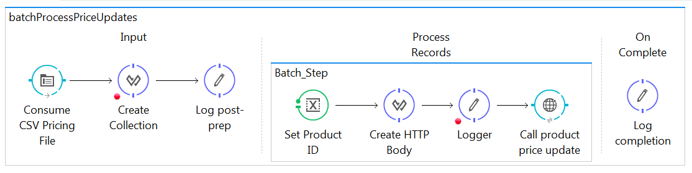
ETL/Batch using Mule Batch Processor
Mule possesses the ability to process messages in batches.
Batch processing is particularly useful when working with the following scenarios:
Integrating data sets, small or large, streaming or not, to parallel process records.
Synchronizing data sets between business applications, such as syncing contacts between Netsuite and Salesforce, effecting "near real-time“ data integration.
Extracting, transforming and loading (ETL) information into a target system, such as uploading data from a flat file (CSV) to Hadoop.
Handling large quantities of incoming data from an API into a legacy system.
Time for a quick demonstration…

Slide 32
<<COMPANY>> ETL Advanced Data Synch Story & Requirements
An example of significant transformation involving other sources for lookup to produce an output to pass into a SaaS solution like Salesforce.
DataWeave with DataSense
How are the data movements secured when being moved via cloud infrastructure?
TLS/SSL, VPC/VPN, Multiple authentication mechanisms.
Brief overview of 3rd party connectors for <<COMPANY>> systems:
MySQL (JDBC), SAP HANA (JDBC), Azure Active Directory (LDAP), Microsoft SQL (JDBC), PeopleSoft (Standard Connector), Salesforce (Standard Connector)
Construction of ETL to transform data?
How are ETL’s versioned and source control?
How are ETL jobs developed, managed and deployed between environments?
How is real-time synch of data supported?
How are dependent ETL jobs orchestrated?
Whiteboard:
How might one architect a refresh of the "employee" records in <LegacyDB>> from<<Salesforce>>…?

Slide 33
Agenda
Changing the Clock Speed of Business
API Led Full Lifecycle Management
ETL with Anypoint Platform
Wrap Up and Next Steps

Slide 34
Wrap Up & Next Steps
Introduction to Business Stakeholders to discuss candidate on-boarding project.
Further conversations with <<COMPANY>> IT up to CIO.
Scoping, Deployment and ROI validation.
<<OTHER>>

Slide 35
Further Reading <<TAILOR>>
Data Validation:
https://blogs.mulesoft.com/dev/tech-ramblings/introducing-the-validations-module/
Data Integrity in Batch Processing:
https://blogs.mulesoft.com/dev/howto/howto-data-integrity-checks-in-batch-processing/
ETL How-to:
https://blogs.mulesoft.com/dev/howto/howto-extract-transform-load-etlchange-data-capture/
PeopleSoft Connector:
https://docs.mulesoft.com/mule-user-guide/v/3.8/peoplesoft-connector
Batch Processing
https://docs.mulesoft.com/mule-user-guide/v/3.8/batch-processing
Connecting to SAP HANA using JDBC
https://www.sap.com/developer/how-tos/2016/08/hxe-connect-hxe-using-jdbc.html

Slide 36
Further Reading <<TAILOR>>
Database Connector:
https://docs.mulesoft.com/mule-user-guide/v/3.8/database-connector
LDAP Connector:
https://docs.mulesoft.com/mule-user-guide/v/3.8/ldap-connector
New release:
https://www.mulesoft.com/press-center/anypoint-crowd-release-api-design-center
Salesforce Connector:
https://docs.mulesoft.com/mule-user-guide/v/3.8/salesforce-connector
Signup for a free trial account…
https://anypoint.mulesoft.com/accounts/
…learn the platform, and join the conversation:
https://training.mulesoft.com/
https://mulesoft.influitive.com/users/sign_in
https://forums.mulesoft.com/index.html

